Slide 1






Lecture 2:
DOM Traversal & Selection
Course - Web Development - II
-By
Instructor Name
welcome@krmangalam.edu.in
Sohna Road,Gurugram,Haryana 122103

Slide 2

| Table of Contents
DOM traversal
getElementById()
getElementsByClassName()
References.
The End.

Slide 3

|
Imagine you're in a room full of people. If you want to say something to one specific person, what’s the first thing you do?

Slide 4

|
Imagine you're in a room full of people. If you want to say something to one specific person, what’s the first thing you do?
You need to identify them — by name, by shirt color, or seat number.
In the same way, JavaScript needs a way to locate and select specific elements on the page — like a button, heading, or paragraph — before it can interact with them.
That's why we use some selecting Elements in JS.

Slide 5
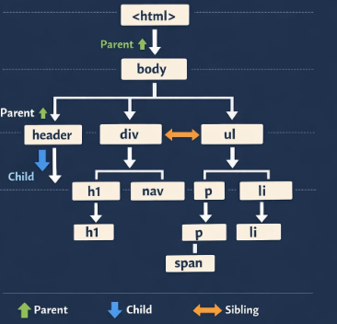
| Introduction to DOM Traversal
DOM Traversal refers to the process of navigating through the DOM tree to access different nodes (elements, text nodes, or attributes) based on their relationships such as parent, child, and sibling.
Since an HTML document is represented as a hierarchical tree structure, DOM traversal enables developers to move up, down, and sideways within this structure to locate and manipulate specific elements dynamically.

Slide 6
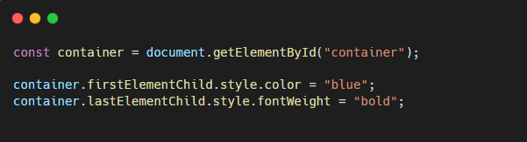
| Introduction to DOM Traversal
Traversal works based on node relationships
Element-based traversal avoids unwanted text nodes
Widely used in frameworks and dynamic UI logic

Slide 7

| Selecting Elements
Selecting elements means accessing or grabbing specific parts of an HTML page (like a heading, button, paragraph, etc.) using JavaScript, so you can read, change, or interact with them.
Think of it like:
“JavaScript is asking: Which part of the page do you want me to work with?”

Slide 8
| Selecting Elements
JavaScript gives us several built-in methods to select elements from the DOM. You choose which one to use based on how you want to target the element — by its ID, class, tag, or more advanced CSS-like selectors.
Some Common Built-in Methods :
getElementById()
getElementsByClassName()
querySelector()
querySelectorAll()

Slide 9
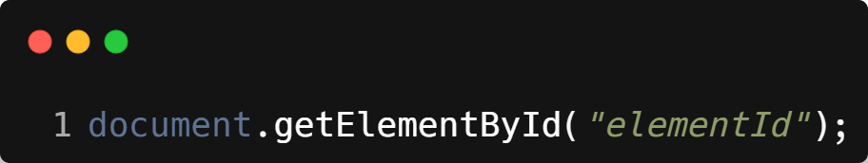
| getElementById()
Selects a single element based on its id attribute.
IDs are unique, so this method always returns one element or null.
Syntax :
Note :
document refers to the entire web page (DOM)
It’s the global object in the browser that represents your loaded HTML page.
It’s like JavaScript’s entry point to interact with the webpage.
Think of document as the gatekeeper to the whole DOM tree.

Slide 10
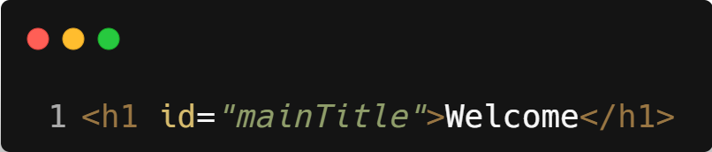
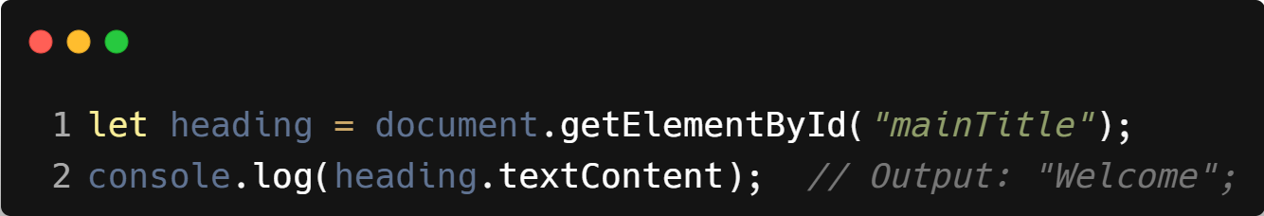
| getElementById()
Example :
HTML
JavaScript
Note :
.textContent is a property that lets you get or change the text inside an element — we’ll study this in detail later in this lecture.

Slide 11
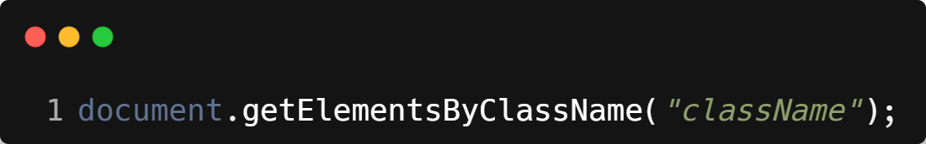
| getElementsByClassName()
Selects all elements that have a specific class name.
Returns an HTMLCollection (array-like, but not a real array).
Syntax :
Returns a live collection of all matching elements.
You need to loop through it for multiple elements.

Slide 12
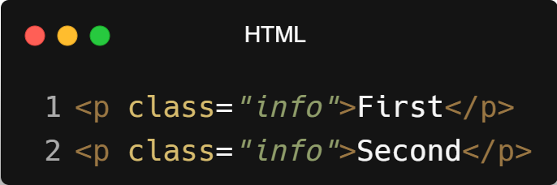
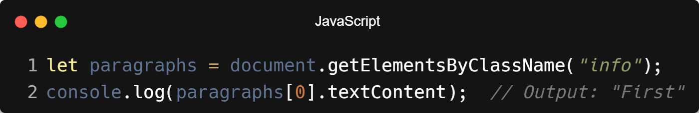
| getElementsByClassName()
Example :

Slide 13
| getElementById()vs getElementsByClassName()
Aspect | getElementById() | getElementsByClassName()
Selection | Single element | Multiple elements
Based on | id | class
Return type | Element | HTMLCollection
Live update | No | Yes
Speed | Faster | Slightly slower

Slide 14

| Check Your Understanding
Question : Which method is the most direct way to select a single HTML element that has a
unique ID?
Options : a) querySelector()
b) getElementsByClassName()
c) getElementById()
d) querySelectorAll()
Answer : c) getElementById()
Explanation:
getElementById() is specifically optimized to find a single element by its unique ID, making it very fast and direct.

Slide 15
| References
MDN Web Docs : Comprehensive and official documentation for JS.
🔗https://developer.mozilla.org/en-US/docs/Web/JavaScript
W3Schools – JS Tutorial : Beginner-friendly JS tutorials with examples and interactive editors.
🔗 https://www.w3schools.com/js/
JavaScript.info - A comprehensive tutorial-style website that covers core JavaScript concepts in depth.
🔗https://javascript.info/

Slide 16
Thanks
For
Watching
Course - Web Development - II
welcome@krmangalam.edu.in
Sohna Road,Gurugram,Haryana 122103

